Slide 1

Investing in Ames
Predicting Sale Prices for Future Investments
Notes:
Good morning everyone. As you know, my name is Ian Irizarry. I was brought on this team to evaluate the real estate market here in Ames, Iowa and to provide a model for predicting future housing prices to help guide your investment decisions here for the future.
But more importantly, I’m here to help inform you because… (change slide)

Slide 2

"An investment in knowledge pays the best interest." - Benjamin Franklin
Notes:
…an investment in knowledge pays the best interest.
Now that I got my corny spiel out of the way, lets get into the good stuff. (change slide)

Slide 3

1. Why are we here?
2. What are we trying to do?
3. Modeling
4. Findings
5. Recommendations
Notes:
So what are we going to focus on today:
Why are we here? No this isn’t a philosophical question. This focuses on our goal. Why we did this analysis.
What are we trying to do? If our goal is an analysis, what is the goal of the analysis. We are going to focus on that here.
Modeling. What is it? What does it do? Why is it valuable?
Findings. What did our analysis show us?
Recommendations. How can we use this new information?

Slide 4

Why are we doing this
Notes:
So, to really understand what I did here, we need to quickly understand why we are doing this. What inspired the need for my investigation? (change slide)

Slide 5
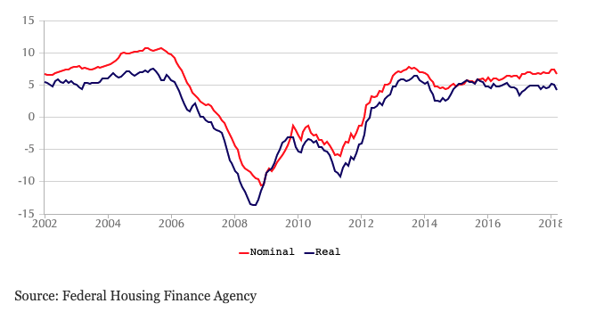
Notes:
As you all know, the real estate market ebs and flows all the time. During hard times the market doesn’t do so great, during the good times it does. But if you look at this chart here, you will notice something. When a downturn or upswing happens, it is not drastic or sudden. Which means, that there are cues that can relay that a decline or upswing may be approaching. The best part? Predictions can increase your chances of making smarter moves before the good and bad times.
So how do we get these predictions? Before we can answer that, there is an important question we need to ask ourselves. (change slide)

Slide 6
Can we use the information we have to predict sales prices?
Notes:
The answer to this question is: it depends. It largely depends on the data but also on whether there is a strong enough relationship between given data ”features” and sales price.
So how do we discover these relationships and make our predictions? (change slide)

Slide 7
Modeling
Notes:
The answer? We model. More specifically, in this case, we use a Linear Regression model. Now some of you may be thinking, what the heck is a Linear Regression?

Slide 8
It displays relationships between variables
It looks at those relationships and identifies trends
Using those trends, it predicts future movement
Notes:
It displays relationships between variables, in this case, we looked at the assessor’s office’s data which included a ton of different variables that impact housing prices.
Next, it looks at those relationships and identifies trends
Finally, it takes those trends and predicts future movement.
Now, because you hired me, you don’t need to know how this stuff works. However, it is important to know that predictions are dependent on the data that we receive. The better the data, the better the predictions. And so, I do need to stress some importance on the process of creating this model for our future use. (change slide)

Slide 9

Model Process
Notes:
I will spare you the details but there are a few things that you need to know regarding the process of creating this model (change slide)

Slide 10
Get the data
Notes:
So the first thing I had to do was to get access to the data, this makes sense. No data, no model. So, in this case, we got our data from the assessor’s office and like many government entities, it's a mess. (change slide)

Slide 11
Get the data
Garbage in, garbage out
Notes:
The next step is particularly important. I have to sort through the data, clean it up, and eliminate any problems that I can find. This is important because the quality of the data that I put into the model will directly influence the accuracy of our predictions. If you put in garbage, you get garbage. (change slide)

Slide 12
Get the data
Garbage in, garbage out
Find connections
Notes:
Once the data is cleaned up and ready to roll, there is still more work to do. Now I have to find the most relevant connections to the sales price. (change slide)

Slide 13
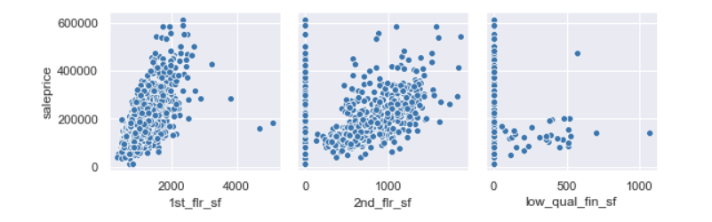
Notes:
Here is an example of a graphic that shows possible relationship. The 1st and 2nd graph demonstrate a good possibility that they influence sales prices. However, the 3rd graph not so much. This means that we will definitely want to include the left graphs but perhaps not the far-right graph. (change slide)

Slide 14
Get the data
Find connections
Make predictions
Garbage in, garbage out
Notes:
Finally, once we have our connections identified, we can now run our model and make predictions.
Now, I hope you are not bored out of your mind yet because we are about to get the good stuff (change slide)

Slide 15
Findings
Notes:
…the findings. So remember, we chose a linear regression model because we want to what variables predict sales prices. That means, we looked for variables that directly influence salesprices. Here is an example of what we are looking for. (change slide)

Slide 16
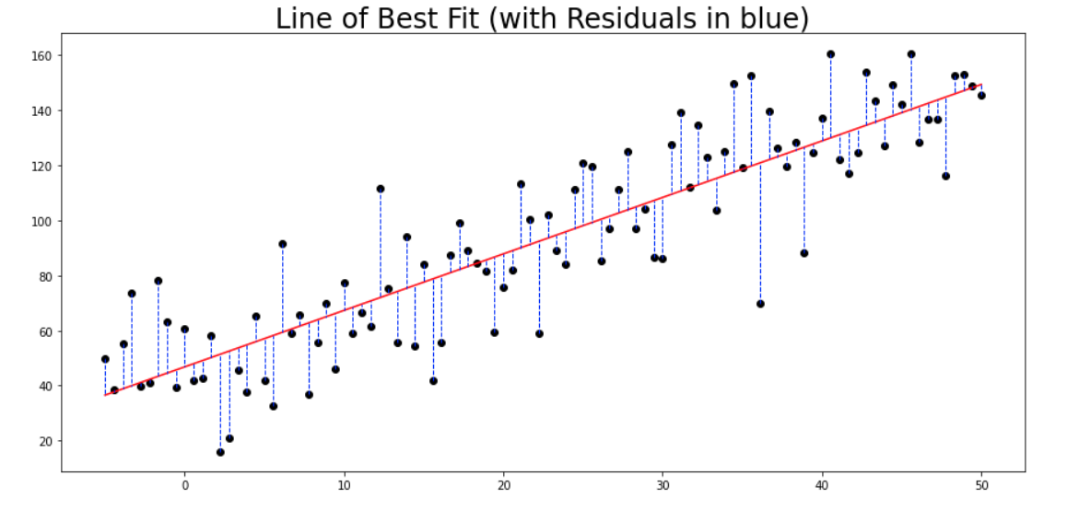
Notes:
There is a lot happening here and you don’t need to know it all. There are two important pieces you need to know here:
That there is a clear direction that the data goes in. Like this graph, you can see the upward angle. That indicates a clear relationship.; and the second is
How accurate our predictive line is to the data. The further away the data is from our line, the more inaccurate our predictions.
Given time constraints, we were not able to identify all the relationships, but I do have a few for you (change slide)

Slide 17
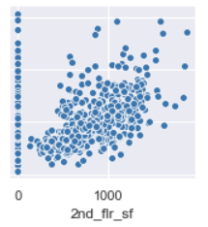
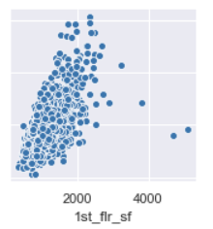
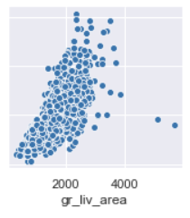
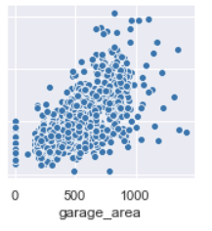
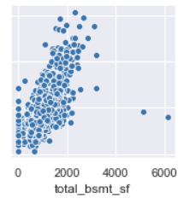
Notes:
Of the 38 features that we used to evaluate connections with sales price, these five showed the greatest promise. You may be wondering what features are. In this case, features are things like, how many bathrooms in the home, how many square feet is the home, is there a garage, how big is that garage, etc. So our of all those features, these five had a direct influence on sales price. And looking at them, it may be obvious why. People want their space. So what does this mean for you? (change slide)

Slide 18

Recommendations
Notes:
This is why we are here right? We want to know what drives prices so that we can have a good idea of what features will directly influence sales prices the most out of everything else. What directly leads to people purchasing a home at a given price point? The answer? Square footage. People love their space. Now how can use this information? Simple. (change slide)

Slide 19
Review predicted prices for square footage
If listing < predicted price, BUY

Slide 20
Questions?

